Slide 1
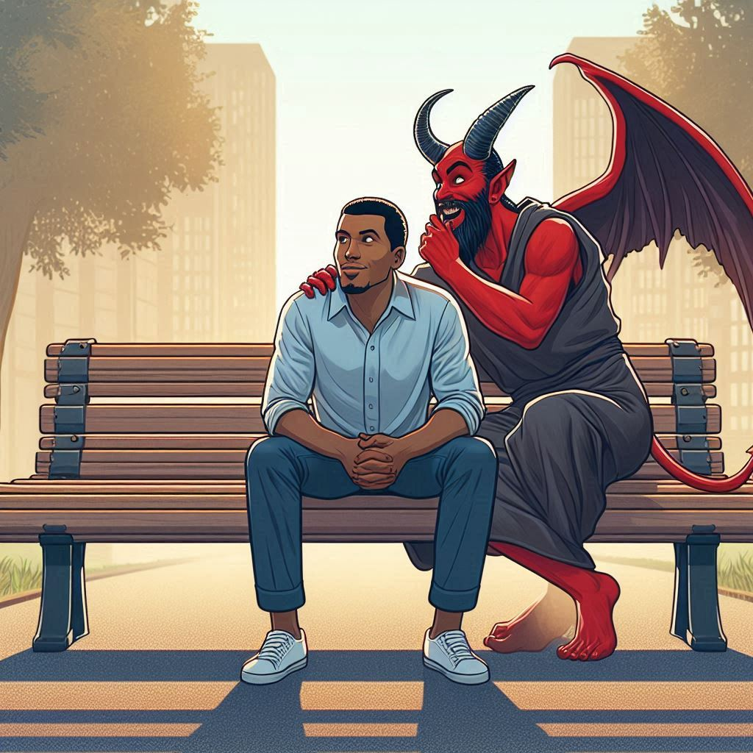
Executing
Satan’s
Devices

Slide 2
DEVICE, noun [Latin]
1. That which is formed by design, or invented; scheme; artificial contrivance; stratagem; project; sometimes in a good sense; more generally in a bad sense, as artifices are usually employed for bad purposes.

Slide 3
To separate grace from truth.
To judge others by our own standards and not the Word of God rightly divided.
Corrupting the Word of God.
Ministering the letter of the new testament.
Handling the word of God deceitfully.

Slide 4
God’s Promises:
Thou shalt surely die
it shall bruise thy head, and thou shalt bruise his heel.
I will bless them that bless thee and curse them that curseth thee

Slide 5
Satan’s Promises:
Ye shall not surely die
Your eyes shall be opened
Ye shall be as gods, knowing good and evil

Slide 6
Satan’s Interventions:
Destroy the woman’s seed – The Flood
Create a New World religion – Confusing the languages
Subvert the natural order of things – Destruction of Sodom and Gomorrah
Kill all of the male children of Israel – Midwives resisted and flourished / Moses adopted by Pharoah’s daughter

Slide 7
Satan works to foil God’s plan by resisting and imitating it in the dispensation that God is using.
When God allows Satan special dispensation to do something he is normally not permitted to do, God takes responsibility for it.
God, in the scriptures, makes Satan liable for the consequences of his actions when those actions are not sanctioned by God.

Slide 8
Matt 26:14-16 ¶ Then one of the twelve, called Judas Iscariot, went unto the chief priests, 15 And said unto them, What will ye give me, and I will deliver him unto you? And they covenanted with him for thirty pieces of silver. 16 And from that time he sought opportunity to betray him.
Mark 14:9-10 Verily I say unto you, Wheresoever this gospel shall be preached throughout the whole world, this also that she hath done shall be spoken of for a memorial of her. 10 And Judas Iscariot, one of the twelve, went unto the chief priests, to betray him unto them.
Luke 22:1-3 ¶ Now the feast of unleavened bread drew nigh, which is called the Passover. 2 And the chief priests and scribes sought how they might kill him; for they feared the people. 3 Then entered Satan into Judas surnamed Iscariot, being of the number of the twelve.

Slide 9
2Cor 4:3-4 But if our gospel be hid, it is hid to them that are lost: 4 In whom the god of this world hath blinded the minds of them which believe not, lest the light of the glorious gospel of Christ, who is the image of God, should shine unto them.
Eph 4:17-19 ¶ This I say therefore, and testify in the Lord, that ye henceforth walk not as other Gentiles walk, in the vanity of their mind, 18 Having the understanding darkened, being alienated from the life of God through the ignorance that is in them, because of the blindness of their heart: 19 Who being past feeling have given themselves over unto lasciviousness, to work all uncleanness with greediness.

Slide 10
Eph 2:1-2 ¶ And you hath he quickened, who were dead in trespasses and sins; 2 Wherein in time past ye walked according to the course of this world, according to the prince of the power of the air, the spirit that now worketh in the children of disobedience:
Eph 2:3 Among whom also we all had our conversation in times past in the lusts of our flesh, fulfilling the desires of the flesh and of the mind; and were by nature the children of wrath, even as others.

Slide 11
Eph 2:1-3 ¶ And you hath he quickened, who were dead in trespasses and sins; 2 Wherein in time past ye walked according to the course of this world, according to the prince of the power of the air, the spirit that now worketh in the children of disobedience: 3 Among whom also we all had our conversation in times past in the lusts of our flesh, fulfilling the desires of the flesh and of the mind; and were by nature the children of wrath, even as others.
Col 1:21 And you, that were sometime alienated and enemies in your mind by wicked works, yet now hath he reconciled

Slide 12
Satan works to foil God’s plan by resisting and imitating it in the dispensation that God is using.
God, in the scriptures, makes Satan liable for the consequences of his actions when those actions are not sanctioned by God.
Satan is responsible for the course of this world. When referring to the course of this world, scripture sometimes personifies it as Satan (Romans 16:20; I Cor. 5:5; I Cor. 7:5; I Tim. 1:20).
The vast majority, if not all, of Satan’s devices are worked out in this dispensation through the course of this world:
The lust of the flesh
The Lust of the eyes
The pride of life

