Slide 1
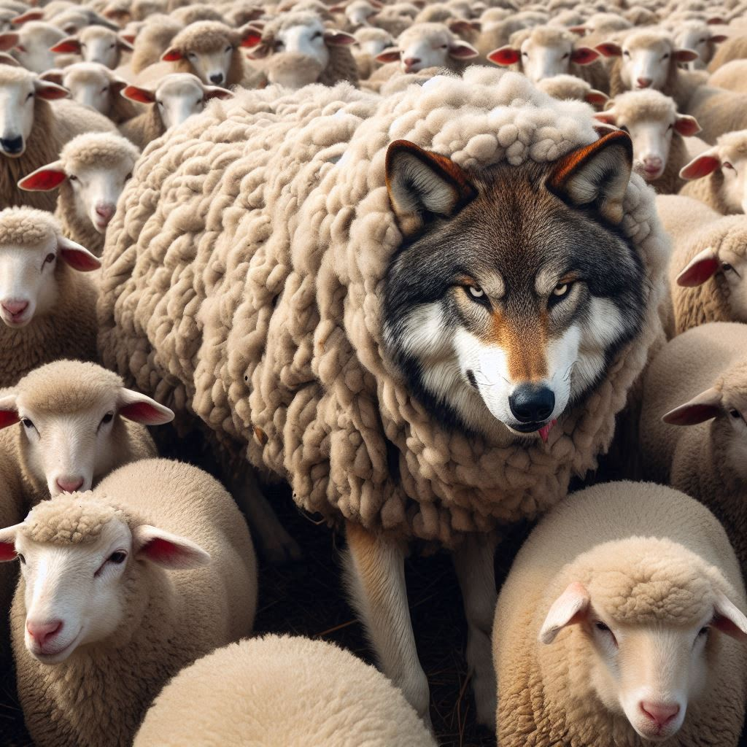
Subtlety

Slide 2
Genesis 3:1
¶ Now the serpent was more subtil than any beast of the field which the LORD God had made. And he said unto the woman, Yea, hath God said, Ye shall not eat of every tree of the garden?
English Standard Version Now the serpent was more crafty than any other beast of the field that the LORD God had made. He said to the woman, “Did God actually say, ‘You shall not eat of any tree in the garden’?”
New International Version Now the serpent was more crafty than any of the wild animals the LORD God had made. He said to the woman, “Did God really say, ‘You must not eat from any tree in the garden’?”

Slide 3
2 Corinthians 11:3
But I fear, lest by any means, as the serpent beguiled Eve through his subtilty, so your minds should be corrupted from the simplicity that is in Christ.
English Standard Version But I am afraid that as the serpent deceived Eve by his cunning, your thoughts will be led astray from a sincere and pure devotion to Christ.
New International Version But I am afraid that just as Eve was deceived by the serpent’s cunning, your minds may somehow be led astray from your sincere and pure devotion to Christ.

Slide 4
John 8:44
Ye are of your father the devil, and the lusts of your father ye will do. He was a murderer from the beginning, and abode not in the truth, because there is no truth in him. When he speaketh a lie, he speaketh of his own: for he is a liar, and the father of it.
New International Version You belong to your father, the devil, and you want to carry out your father’s desires. He was a murderer from the beginning, not holding to the truth, for there is no truth in him. When he lies, he speaks his native language, for he is a liar and the father of lies.
English Standard Version
You are of your father the devil, and your will is to do your father’s desires. He was a murderer from the beginning, and does not stand in the truth, because there is no truth in him. When he lies, he speaks out of his own character, for he is a liar and the father of lies.

Slide 5
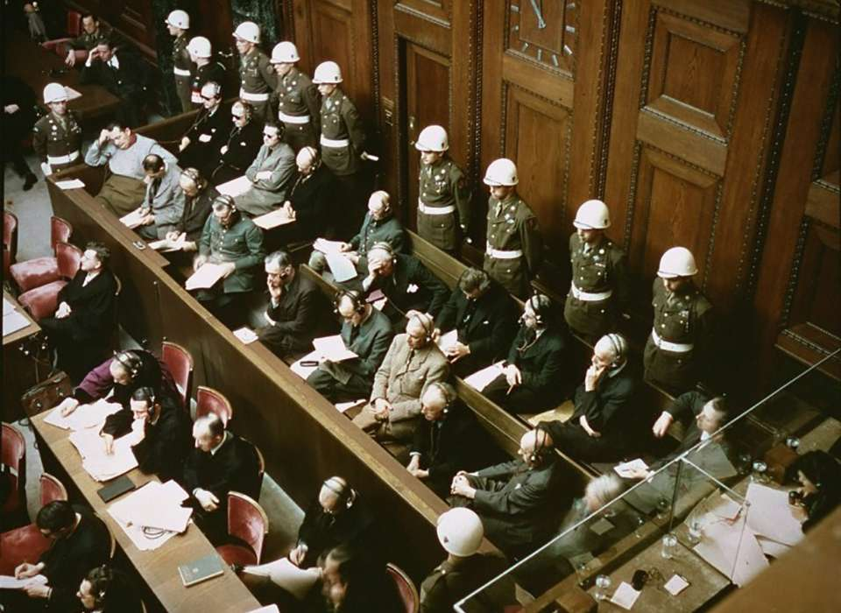
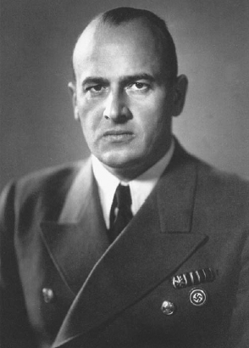
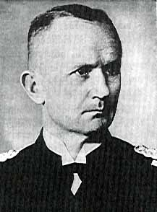
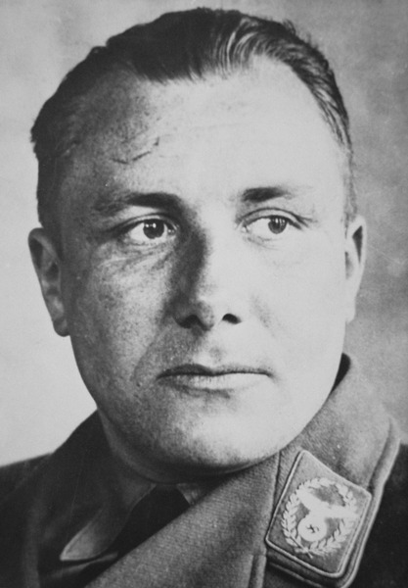
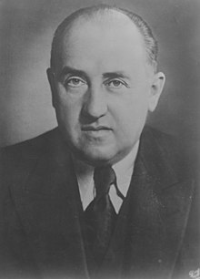
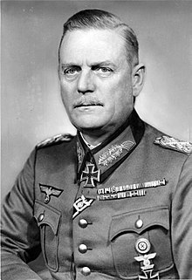
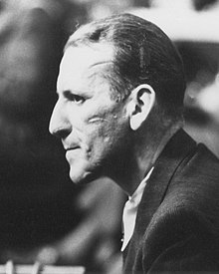
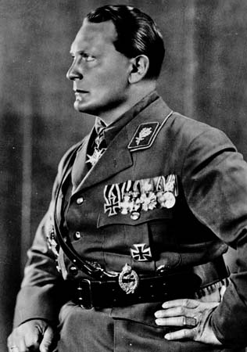
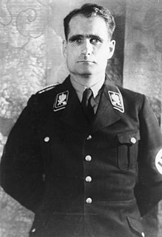
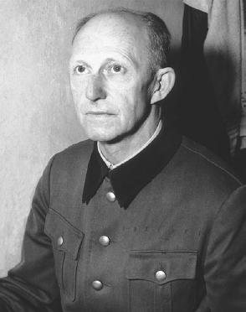
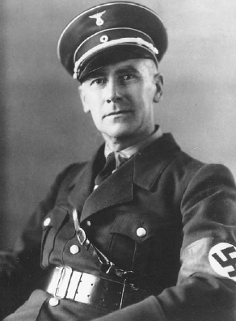
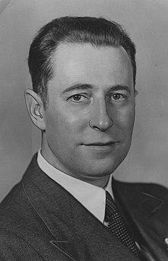
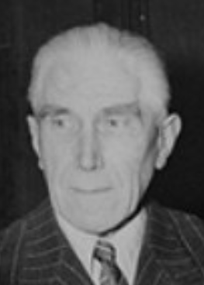
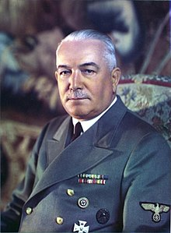
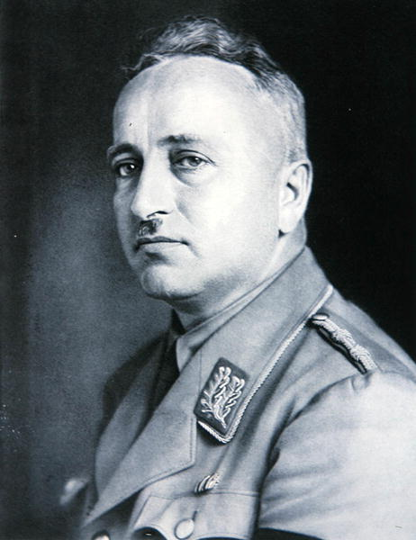

Slide 6
Prov 6:16-19
These six things doth the LORD hate: yea, seven are an abomination unto him: 17 A proud look, a lying tongue, and hands that shed innocent blood, 18 An heart that deviseth wicked imaginations, feet that be swift in running to mischief, 19 A false witness that speaketh lies, and he that soweth discord among brethren.
New International Version
16 There are six things the Lord hates, seven that are detestable to him: 17 haughty eyes, a lying tongue, hands that shed innocent blood, 18 a heart that devises wicked schemes, feet that are quick to rush into evil, 19 a false witness who pours out lies and a person who stirs up conflict in the community.
English Standard Version
16 There are six things that the Lord hates, seven that are an abomination to him: 17 haughty eyes, a lying tongue, and hands that shed innocent blood, 18 a heart that devises wicked plans, feet that make haste to run to evil, 19 a false witness who breathes out lies,and one who sows discord among brothers.

Slide 7
Ezekiel 28:17
Thine heart was lifted up because of thy beauty, thou hast corrupted thy wisdom by reason of thy brightness: I will cast thee to the ground, I will lay thee before kings, that they may behold thee.
New International Version Your heart became proud on account of your beauty, and you corrupted your wisdom because of your splendor. So I threw you to the earth; I made a spectacle of you before kings.
English Standard Version Your heart was proud because of your beauty; you corrupted your wisdom for the sake of your splendor. I cast you to the ground; I exposed you before kings, to feast their eyes on you.

Slide 8
2Thessalonians 2:10
And with all deceivableness of unrighteousness in them that perish; because they received not the love of the truth, that they might be saved.
New International Version and all the ways that wickedness deceives those who are perishing. They perish because they refused to love the truth and so be saved.
English Standard Version and with all wicked deception for those who are perishing, because they refused to love the truth and so be saved

Slide 9
1Peter 5:8-9
¶ Be sober, be vigilant; because your adversary the devil, as a roaring lion, walketh about, seeking whom he may devour: 9 Whom resist stedfast in the faith, knowing that the same afflictions are accomplished in your brethren that are in the world.
New International Version
⁸ Be alert and of sober mind. Your enemy the devil prowls around like a roaring lion looking for someone to devour. ⁹ Resist him, standing firm in the faith, because you know that the family of believers throughout the world is undergoing the same kind of sufferings
English Standard Version
⁸ Be sober-minded; be watchful. Your adversary the devil prowls around like a roaring lion, seeking someone to devour. ⁹ Resist him, firm in your faith, knowing that the same kinds of suffering are being experienced by your brotherhood throughout the world.

Slide 10
2Corinthians 11:13-15
For such are false apostles, deceitful workers, transforming themselves into the apostles of Christ. 14 And no marvel; for Satan himself is transformed into an angel of light. 15 Therefore it is no great thing if his ministers also be transformed as the ministers of righteousness; whose end shall be according to their works.
New International Version
13For such people are false apostles, deceitful workers, masquerading as apostles of Christ. 14And no wonder, for Satan himself masquerades as an angel of light. 15It is not surprising, then, if his servants also masquerade as servants of righteousness. Their end will be what their actions deserve.
English Standard Version
13For such men are false apostles, deceitful workmen, disguising themselves as apostles of Christ. 14And no wonder, for even Satan disguises himself as an angel of light. 15So it is no surprise if his servants, also, disguise themselves as servants of righteousness. Their end will correspond to their deeds.

Slide 11
2Corinthians 11:5
¶ For I suppose I was not a whit behind the very chiefest apostles.
New International Version I do not think I am in the least inferior to those “super-apostles.”
English Standard Version Indeed, I consider that I am not in the least inferior to these super-apostles.

Slide 12
Yea, Hath God Said?

